Slide 1

Netflix Movies dataset
IST 707 – Data Analytics
Thomas Marianos - Patrick aslakson

Slide 2
concept
Evaluate Movie and TV listings on Netflix and determine the most popular by Country
Attempt to predict the “Country” categories for these Movies

Slide 3
strategy
Clustering
Support Vector Machines
Naïve Bayes
Decision Trees

Slide 4
Data Source
https://www.kaggle.com/shivamb/netflix-shows

Slide 5
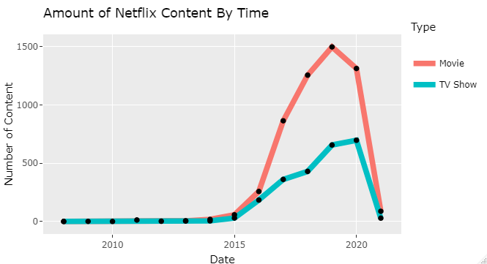
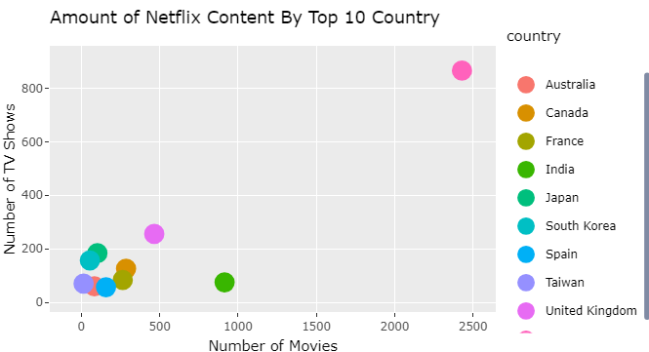
Data

Slide 6
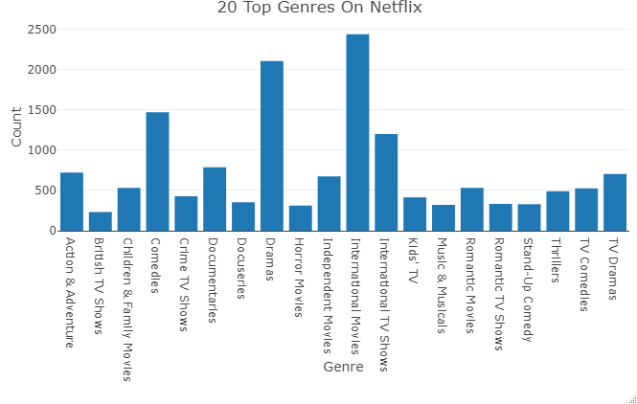
Data

Slide 7
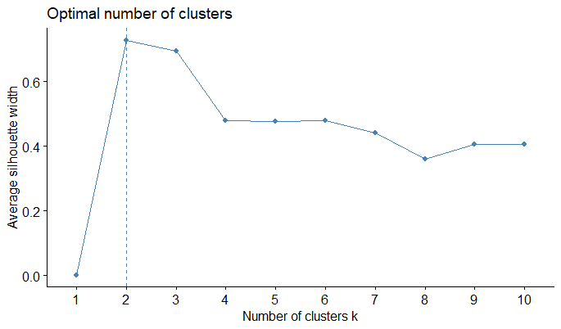
Clustering

Slide 8
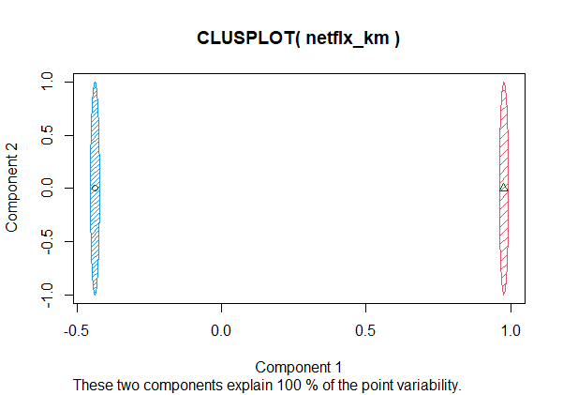
Clustering

Slide 9
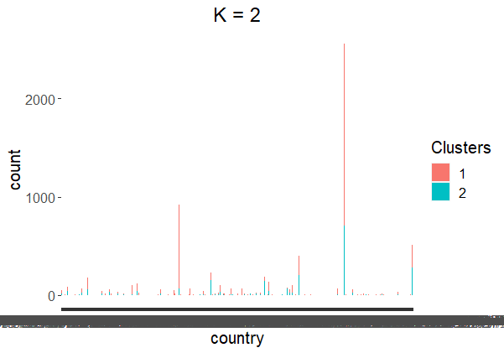
Clustering

Slide 10
Clustering

Slide 11
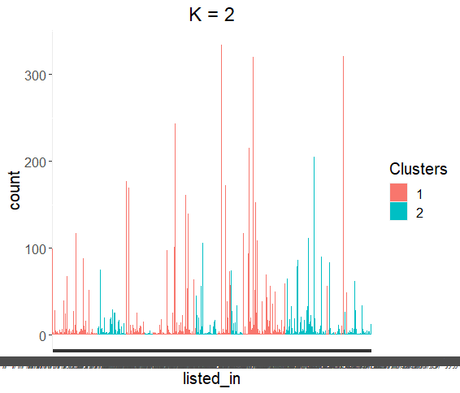
Clustering

Slide 12
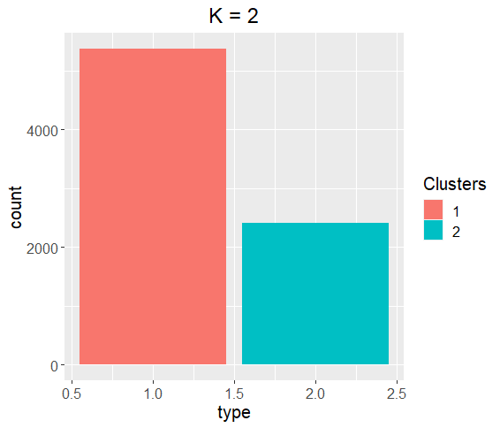
Clustering

Slide 13
SVM
Data Recipe
Inputs:
role #variables
outcome 1
predictor 1
Operations:
Tokenization for description
Text filtering for description
Term frequency-inverse document frequency with description
Centering and scaling for all_numeric_predictors()
SMOTE based on type

Slide 14
SVM
== Workflow ==================================================================
Preprocessor: Recipe
Model: svm_linear()
-- Preprocessor --------------------------------------------------------------
5 Recipe Steps
* step_tokenize()
* step_tokenfilter()
* step_tfidf()
* step_normalize()
* step_smote()
-- Model ---------------------------------------------------------------------
Linear Support Vector Machine Specification (classification)
Computational engine: LiblineaR

Slide 15
SVM
First Fit
.metric .estimator mean n std_err .config
1 accuracy binary 0.676 10 0.00876 Preprocessor1_Model1
2 precision binary 0.788 10 0.00591 Preprocessor1_Model1
3 recall binary 0.727 10 0.00852 Preprocessor1_Model1
Final Fit
.metric .estimator .estimate .config
1 accuracy binary 0.688 Preprocessor1_Model1
2 recall binary 0.728 Preprocessor1_Model1
3 precision binary 0.802 Preprocessor1_Model1

Slide 16
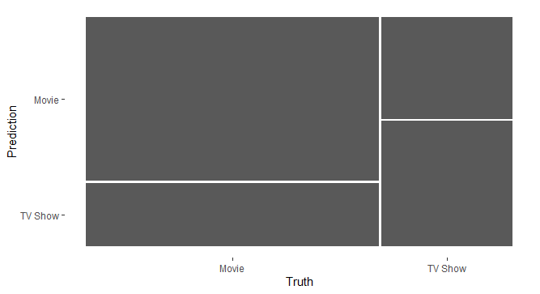
svm
Truth
Prediction Movie TV Show
Movie 979 242
TV Show 366 361

Slide 17
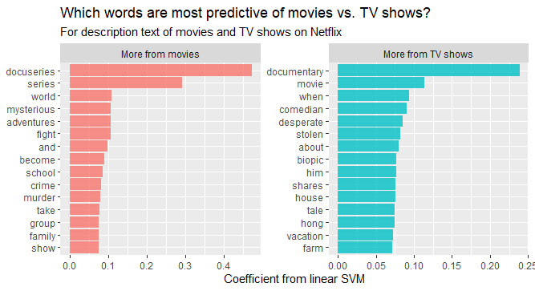
svm

Slide 18
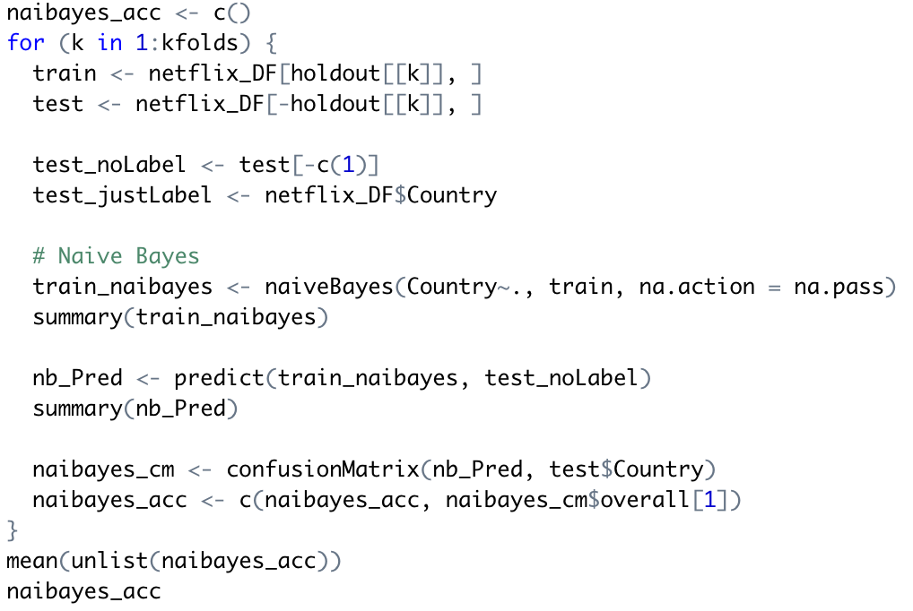
Naïve bayes
Accuracy: 1.21

Slide 19
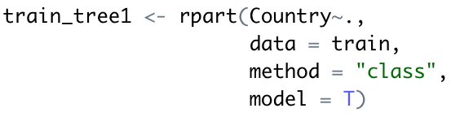
Decision Tree 1

Slide 20
Decision Tree 1
Accuracy: 85.51

Slide 21
Decision Tree 1
Pruned
train_tree_p1 <- prune(train_tree1, cp = 0.012)

Slide 22
Decision Tree 1
Pruned
Accuracy: 84.21

Slide 23
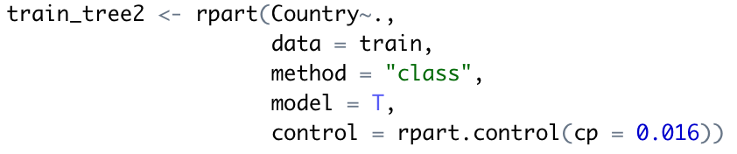
Decision Tree 2

Slide 24
Decision Tree 2
Accuracy: 80.03

Slide 25
Conclusion
Of the four models we ran, the most accurate was the decision trees with ~84.21 – 85.51% accuracy
Using the Descriptions and Listed In tags for movies provided by Netflix in each country, we found that the strongest words for classification of the trees, were descriptive words of the setting country or nationality of characters

